Slide 1

Avon Valley
Indoor Bowls Club
The Early Years
1975-1980

Slide 2
In May 1975
Bill Lewis ( a former President of The English Bowls Association) and a bowling friend, Graham Howard were driving past the disused R.A.F. station at Gaydon when Bill spots the potential of the derelict "Officers Mess" building as an indoor bowls venue.

Slide 3
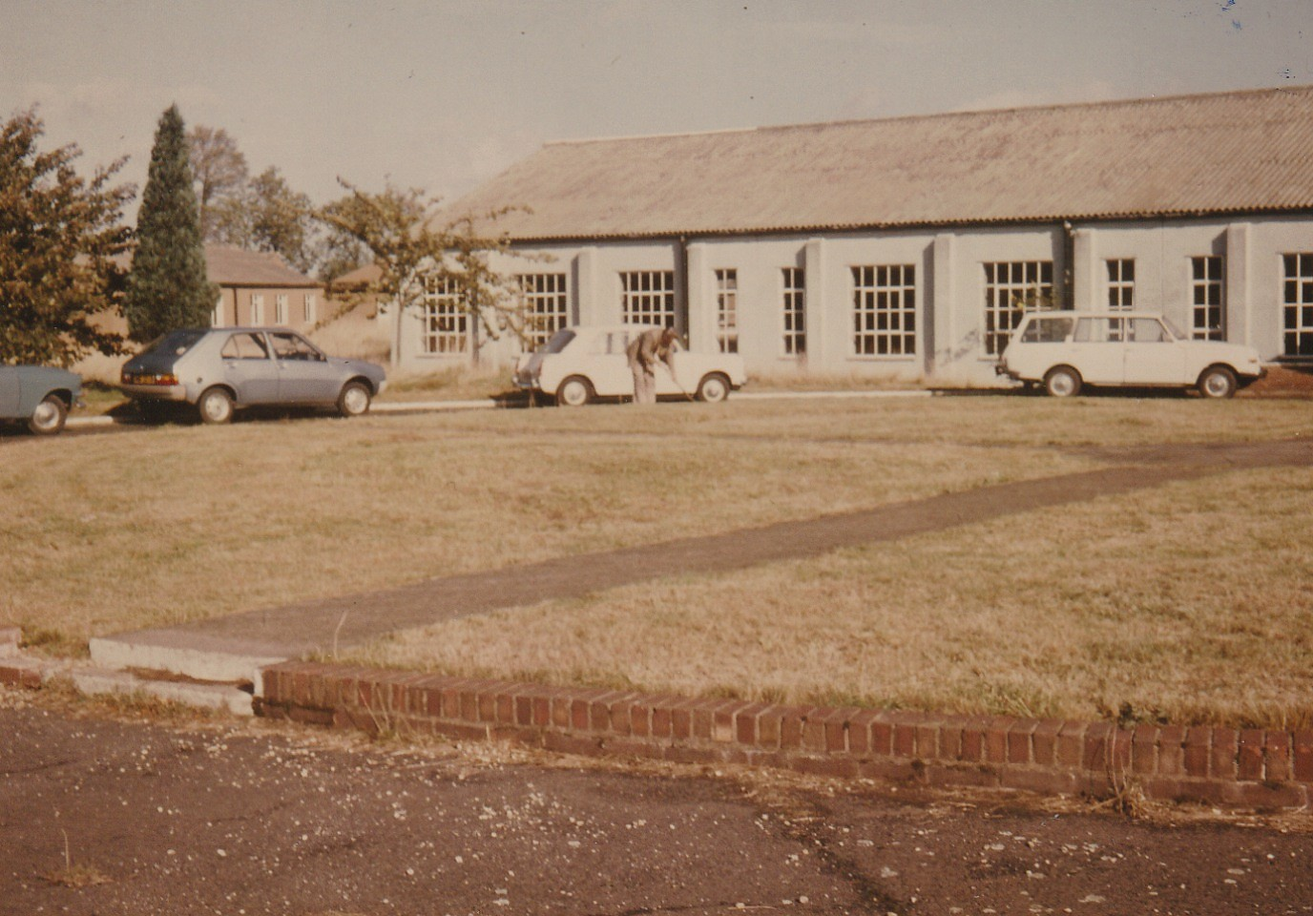

Slide 4
Bill discusses with his fellow bowlers the possibility of using the building for indoor bowls.
Negotiations with various agencies ensued and a six month lease was granted.

Slide 5
Bill and a band of bowling enthusiasts formed AVIBC by converting the then disused officers mess and were able to start bowling.

Slide 6
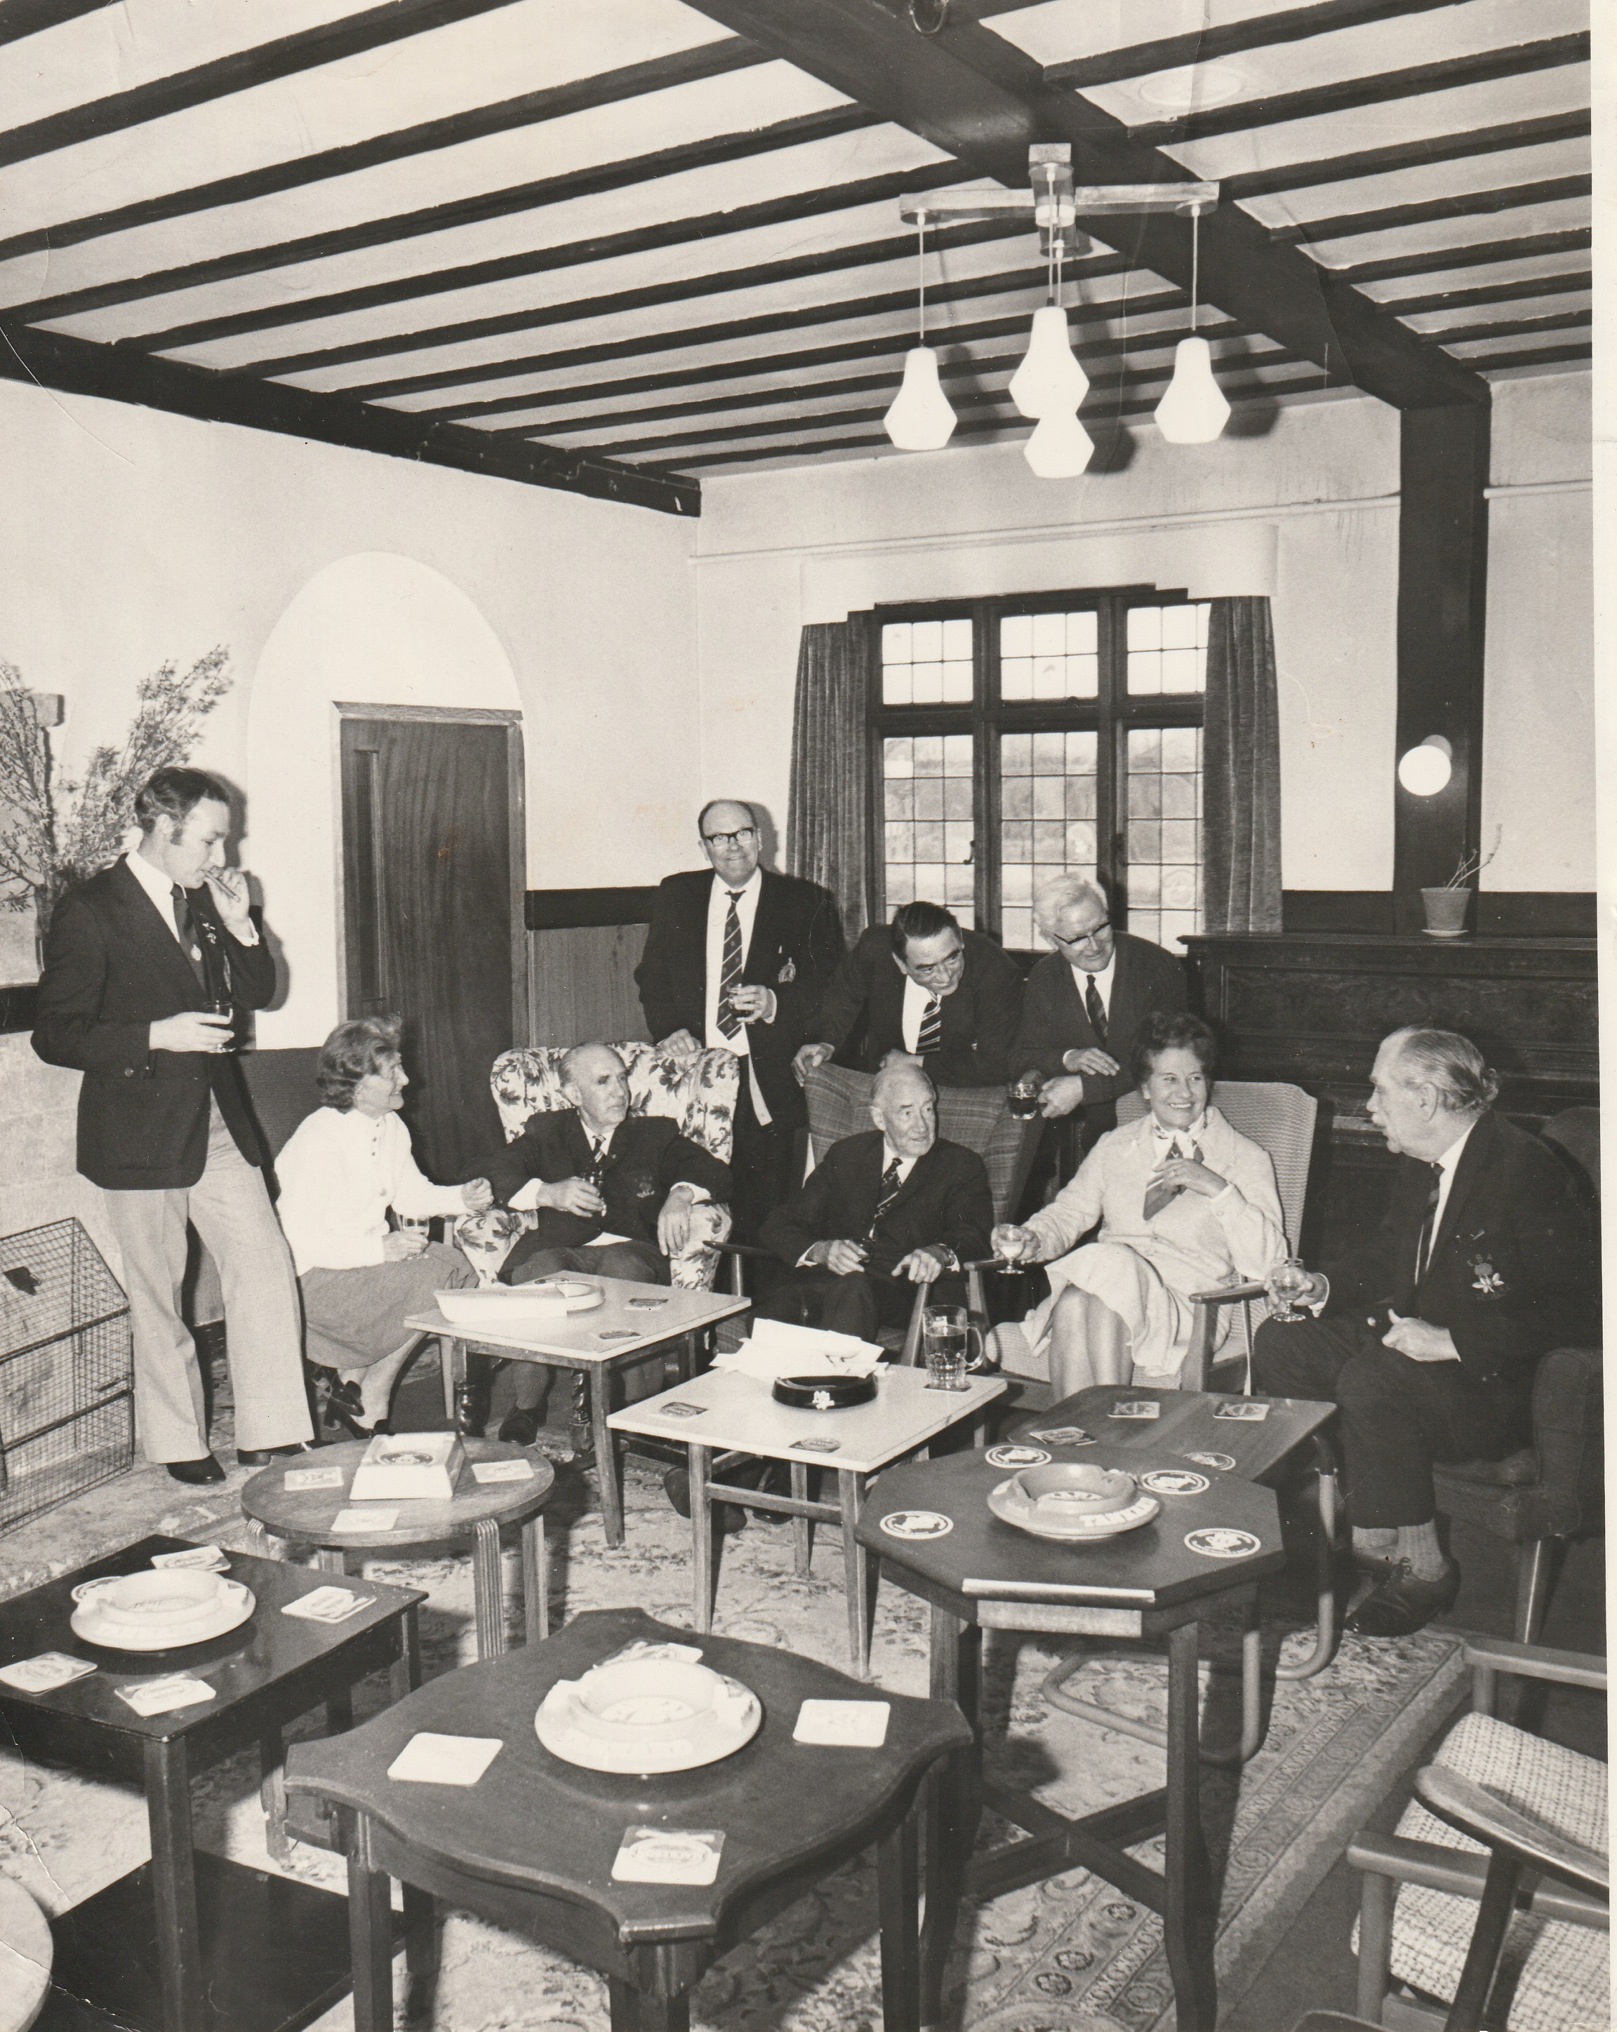

Slide 7
1977
During 1977 British Leyland were negotiating the purchase of the whole airfield.
late 1977
British Leyland acquired the site in late 1977
Apr. 1979
AVIBC lease was extended to April 1979

Slide 8
More negotiations in 1977 resulted in British Leyland offering AVIBC a 3 acre site with a 42 year lease which they accepted.
British Leyland also offered a grant towards development of a new indoor bowls centre. Stratford District Council matched that grant and the sports council also added a grant

Slide 9
In June 1979, building started on the new AVIBC.
A retired builder, and a band of bowling enthusiasts built the new clubhouse. Refurbishing doors, windows, stone, timber, sanitary fittings, lamp shades etc from the officer’s mess.

Slide 10
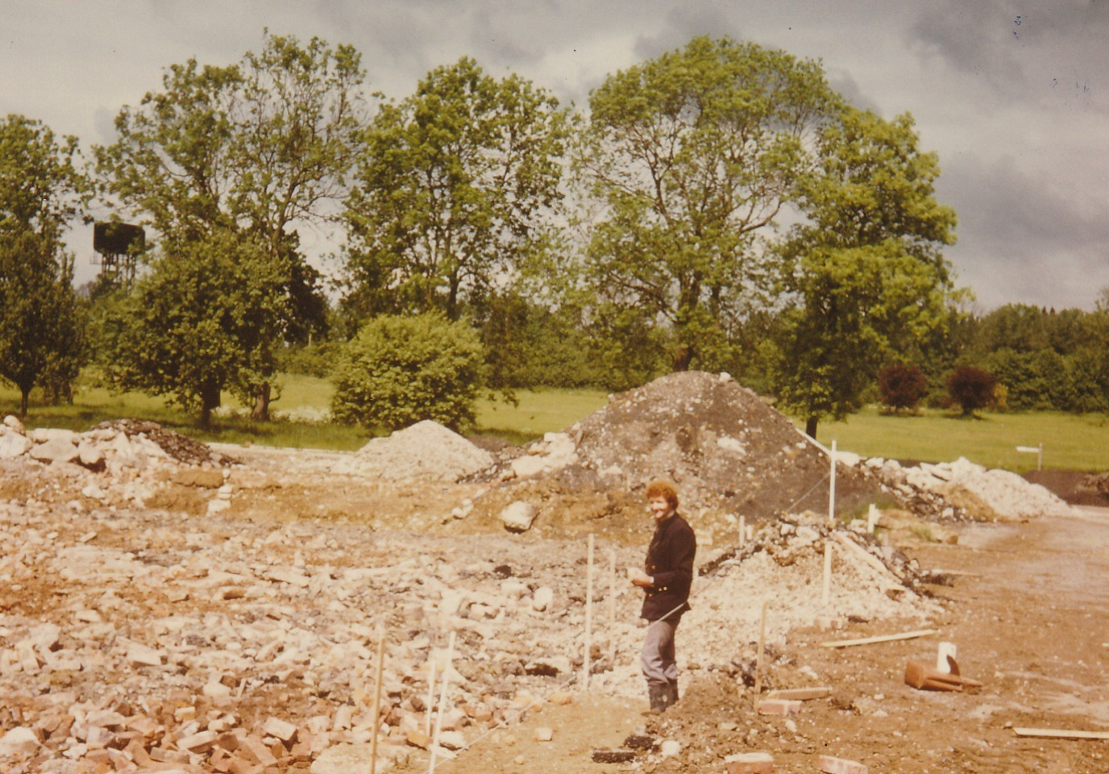
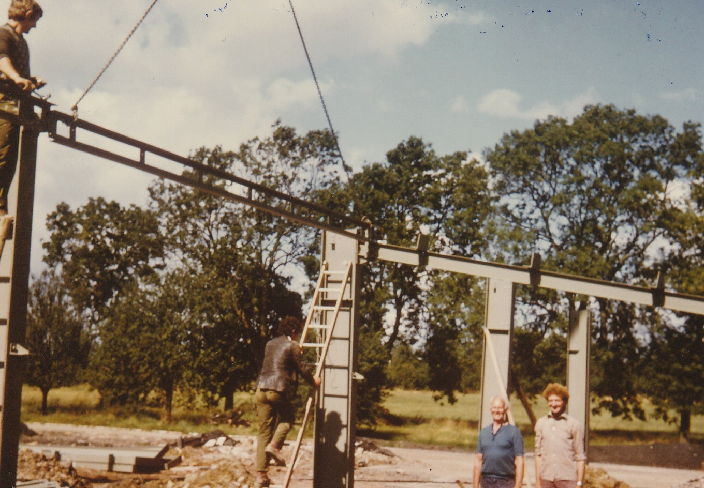
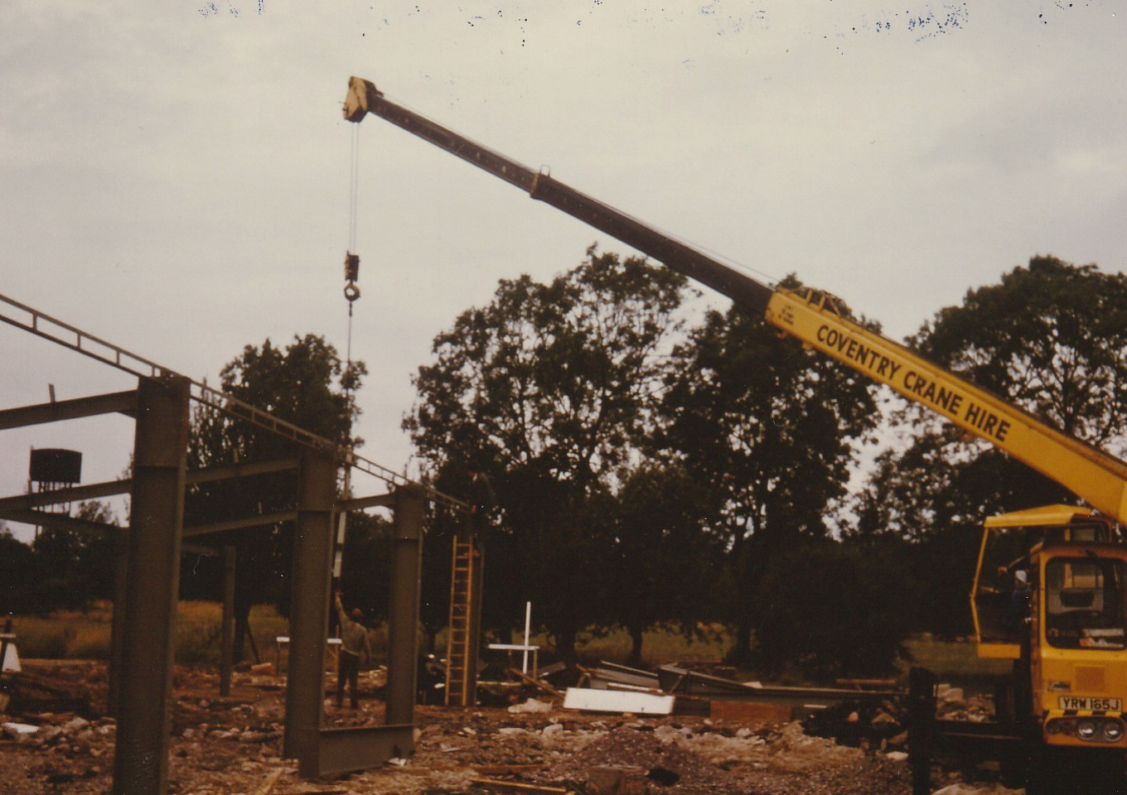
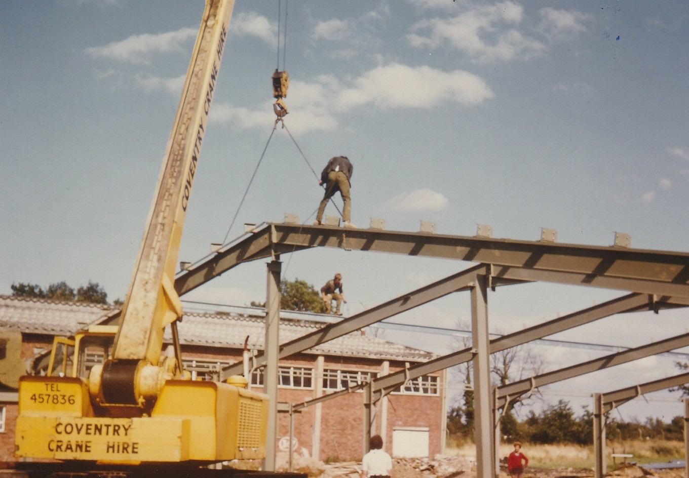

Slide 11
In October 1980 the AVIBC was officially opened.

Slide 12
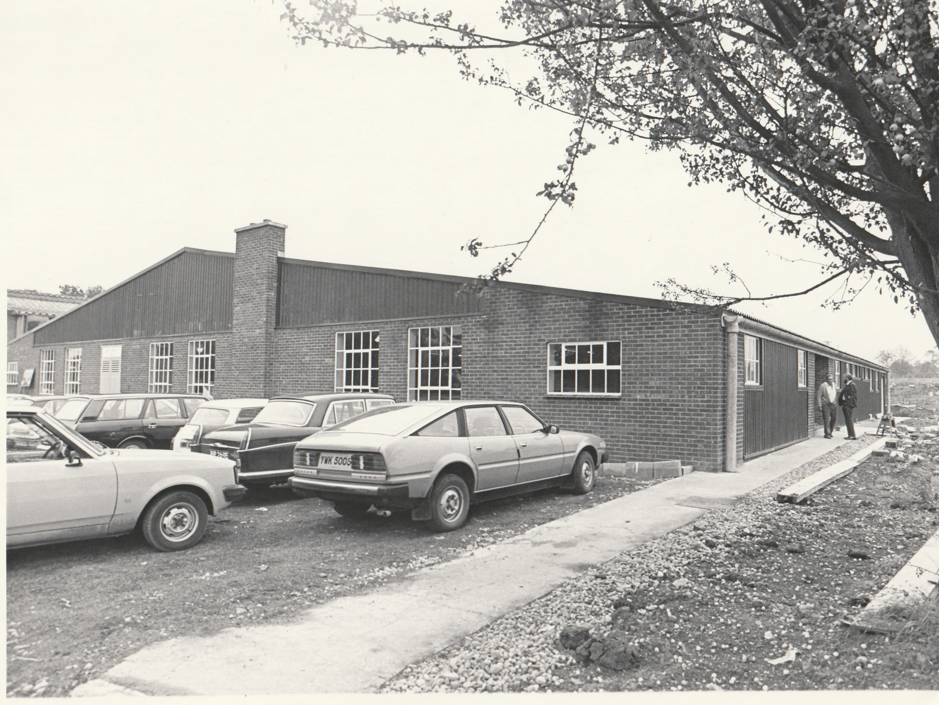

Slide 13
